Slide 1
TAPS Fall Conference
October 29, 2019

Slide 2
Welcome to Wisconsin
The first ice cream sundae was concocted in 1881 in WPPI member community Two Rivers.
WPPI member Prairie du Sac, hosts the world’s largest cow chip throwing competition each year.
The Wisconsin Dells has the world's largest concentration of water parks all in one area.
Wisconsin produces more cheese than any other state in the nation - with several of the largest served by WPPI members
If all of the hunters on opening day of deer season in Wisconsin were grouped together, they would comprise the sixth largest army in the world.

Slide 3
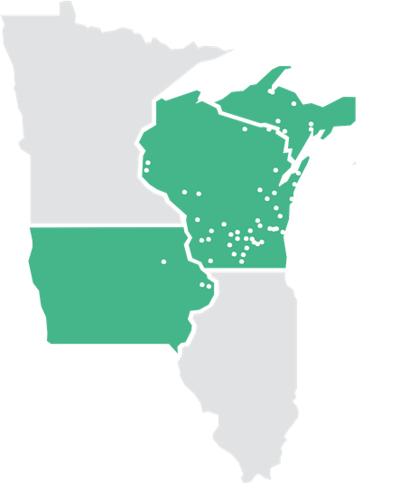
WPPI by the Numbers
1980
51 and 3
110
200,000
1,050
Notes:
1980 -- What was happening when WPPI was formed? Relate to story from history book, if using as intro.
51 member-owners in 3 states today – Each with seat on board
200,000 homes and businesses
110 - professional staffers with broad range of expertise to serve you
77-80% - Approximate portion of your customers’ bills that originates with WPPI - Illustrates why members should be informed, engaged and involved in our joint action agency
1,050 MW all-time system-wide peak, illustrates combined buying power of members working together

Slide 4
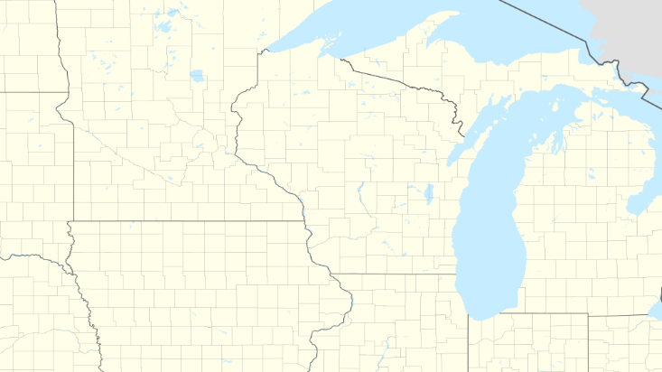







System purchases:
WEPCO (WI Electric Power Co.), 50 MW
WPS ( WI Public Service), 150 MW
Boswell
Point Beach Solar, 2022 Jun 1
Island Street
Point Beach Nuclear
South Fond du Lac
Top of Iowa II
Butler Ridge
Forward
Barton
Elm Road
Bishop Hill III
Nelson
Notes:
Source: eDoc #364015, animation removed

Slide 5
Wholesale Rate Design Average Power Cost ($/MWh)

Slide 6
New Energy Rate Design

Slide 7
Average Power Costs to Members
*Projected
Notes:
Our focus is always on stability and competitiveness for your community.
Here’s a look at how we’re performing.
We are highly competitive among our peer wholesale electric suppliers and we expect to continue making solid gains in this area.
As this graph illustrates, we have held our average wholesale power cost to members relatively flat for more than the past five years.
We expect to continue doing so for the five year period ahead.
In 2018, our average wholesale power cost to members decreased 7.4%.
2018 represented our lowest average power cost since 2009.

Slide 8








ADVANCED
METERS
MY ACCOUNT
SELF-SERVICE
NORTHSTAR
CUSTOMER INFORMATION
SYSTEM
METER DATA
MANAGEMENT
INFOSEND
RETAIL BILLING
SHARED METER
TECHNICIANS
OUTAGE
MANAGEMENT
RETAIL BILLING &
TARIFF COMPLIANCE
Notes:
Meet customer expectations (today and in the future)
Provide proactive customer service
Have more information on your customers
Allow customers to see how they use electricity
Allow accurate allocation of costs (rate case work)
Allow energy service representatives to provide energy efficiency programs
Over 400 member staff use our hosted systems

Slide 9
Thank You
Mike Peters
President & CEO
mpeters@wppienergy.org

