Slide 1


Great Lakes Utilities
TAPS 2019 Fall Conference
October 29, 2019

Slide 2
Outline
Overview of Great Lakes Utilities (GLU)
Organizational Structure
Strategic Focus: 2020-2022
Questions
Notes:
2

Slide 3
Great Lakes Utilities
Great Lakes Utilities (GLU) is a municipal electric company formed under Wisconsin Statutes, Section 66.0825, in 2000.
GLU is a “project” agency, not a “full requirements” joint action agency.
  Key difference from “full requirements” agency is that Member chooses level of participation in projects, which provides more autonomy to member
GLU is a public body, but does not have taxing power.
Second largest joint action agency in Wisconsin.
Member-owner of Hometown Connections Inc.

Slide 4
Mission, Vision, Values
Mission Statement
Providing value to our members through offering reliable and cost effective solutions centered on power supply to enhance the quality of life in each of the communities.
Vision Statement
To strengthen our members local status by enhanced service offering, cost effective power supply solutions, and increased member participation.
Values
  Commitment: Everyone is accountable for success.
  Member Focus: Provide value to our members and the communities we serve.
  Operational Excellence: Meet and exceed Utilities best practice for cost, reliability and service expectations.
  Stewardship: Efficiently manage our financial, environmental and regulatory responsibilities.
  Innovation: Develop creative solutions that enhance service offerings.
Notes:
4

Slide 5
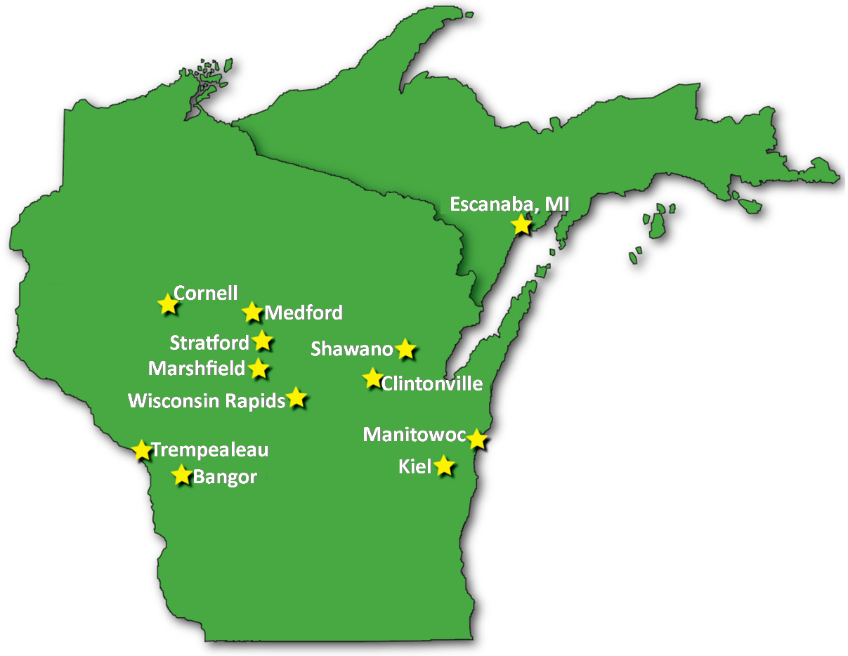
Membership of GLU
12 Public Power utility members in Wisconsin and Upper Michigan
Notes:
5

Slide 6
Overview of GLU
2018 Peak Demand: 395 MW
2018 Total Load: 2.1 million MWH
Load Factor: 60.35%
Largest Member: Manitowoc Public Utilities (MPU), WI
  Peak Load: 105 MW
Smallest Member: Cornell, WI
  Peak Load: 2.5 MW
All load in MISO
  8 members in Zone 2 (American Transmission Company footprint)
  4 members in Zone 1 (Xcel Energy Transmission footprint)
Annual Budget: $100 million
Notes:
6

Slide 7
GLU Organization and Management
Board is made up of representatives from each municipality
As a project agency, GLU’s members participate only in the projects or services they find value.
When fewer than all members participate in a project or service, a project committee is formed to manage the project, with only those members with similar interests participating.
Decisions of the project committee are submitted to the GLU Board for formal approval or disapproval; however, the Board may not alter, amend, or modify project committee decisions.

Slide 8
GLU Organization and Management (cont’d)
No paid staff on GLU payroll
All services, except legal, contracted through Manitowoc Public Utilities
Board of Directors
Bangor (R. Pelowski) Clintonville (B. Ellickson)
Cornell (D. DeJongh, Treasurer) Escanaba, MI (M. Furmanski)
Kiel (K. August) Manitowoc (N. Kothari)
Marshfield (N. Kumm) Medford (J. Fales, Secretary)
Shawano (B. Knapp, Vice Chair) Stratford (S. Dennee)
Trempealeau (K. Wood) Wisconsin Rapids (J. Brown, Chair)
Power Supply Committee
(Jem Brown)
Lakeswind Project Committee
(John Fales)
GLU West Project Committee
(Dave DeJongh)
Administrative and Operating Services (MPU)
(Nilaksh Kothari: Managing Director)
Notes:
8

Slide 9
GLU Value to Members
Agreements with multiple suppliers allow for short, medium and long term transactions (similar to other JAA)
GLU aggregates all contracts to provide least cost option with low risk
Full participation & transparency– Committees review options and makes decisions
GLU administrative and operational services provided at cost through MPU (GLU member)
Four rate decreases in wholesale power cost to its members in last six years
Notes:
9

Slide 10
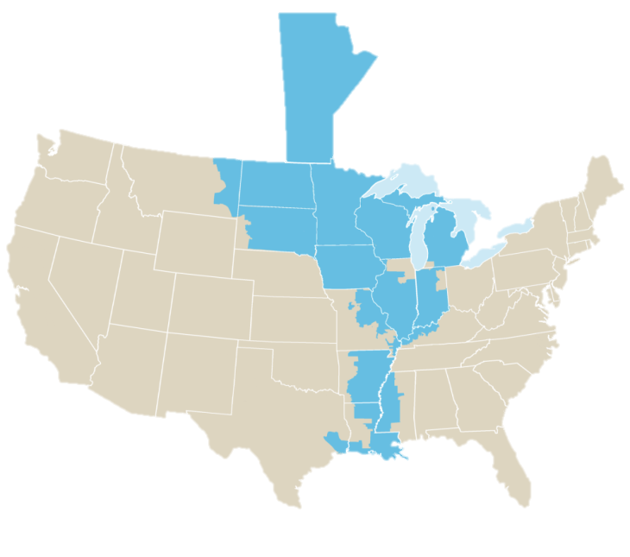
GLU Committees
Power Supply Committees
(East and West)
Total peak load over 250 MW
Full or partial requirements power supply provided to members
Annual power supply planning process
Currently no ownership in generating assets
Other Services
MISO
  Provides MISO market services under GLU umbrella
  24-hour desk on an as needed basis to members
Rate case filings at PSCW
AMI planning, engineering, and implementation

Slide 11
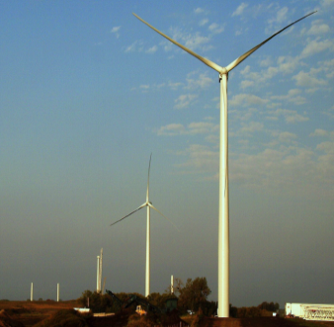
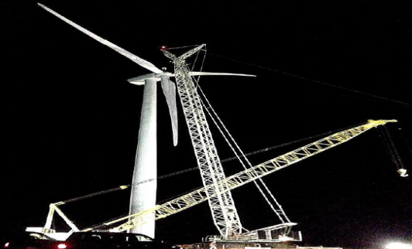
Wind Project Committee
50 MW wind farm – 20 year PPA at fixed price. GLU’s off-take 80%.
Project Operational in March 2014.
Wind Farm registered as Intermittent Resource with MISO rather than Dispatchable Intermittent Resource by MISO.
Will meet renewable energy requirements of GLU and its members for many years under current laws.
Notes:
11

Slide 12
Strategic Focus: 2020-2022
Planning and implementing long-term, cost effective generation ownership.
Succession planning and leadership transition with Nilaksh Kothari, Managing Director, upcoming retirement.
Enhance value of GLU to its members.
Notes:
12

Slide 13
Summary
As a project agency, GLU provides members the flexibility of participating in projects and/or services they desire.
Second largest joint action agency in Wisconsin.
Long term full requirements contracts enable GLU to provide power supply planning, obtain necessary resources, and create an integrated power supply load to manage costs.
GLU is a not for profit organization owned by the members for the sole purpose of serving member communities (not shareholders).
Thank you TAPS members for hosting a meeting in Wisconsin!

Slide 14
Questions
nkothari@greatlakesutilities.org
Notes:
14

