Slide 1
TAPS 2019 Fall Conference
David Kelley
Director, Seams and Market Design
October 29, 2019

Slide 2
Who we are

Slide 3
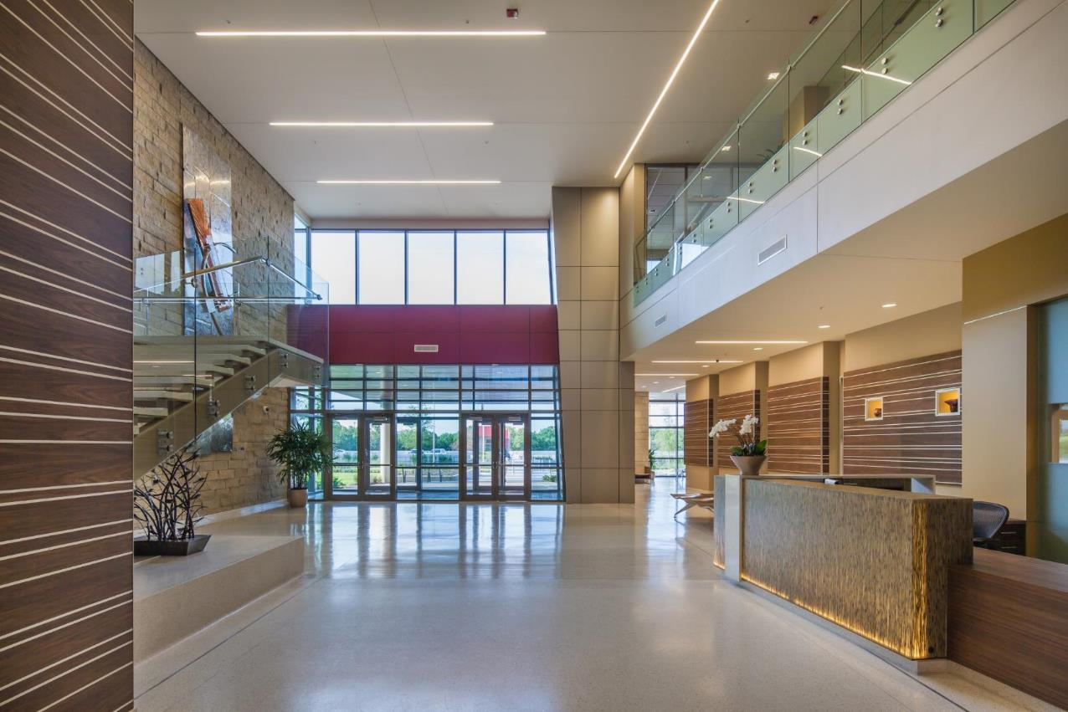
SPP At a Glance
Located in Little Rock
Approx. 600 employees
Jobs in IT, electrical engineering, operations, settlements and more
24x7 operation
Full redundancy and backup site

Slide 4
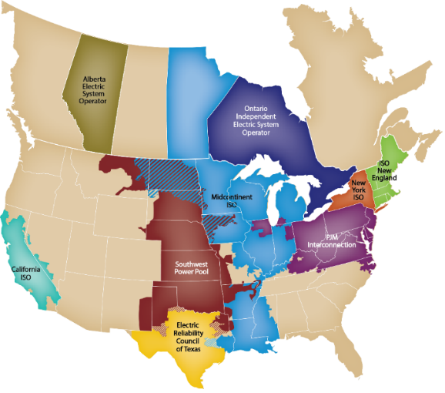
North American
Independent System Operators (ISO) and Regional Transmission Organizations (RTO)
Notes:
This map depicts the 10 other FERC-approved Independent System Operators and Regional Transmission Organizations in the United States and Canada.

Slide 5
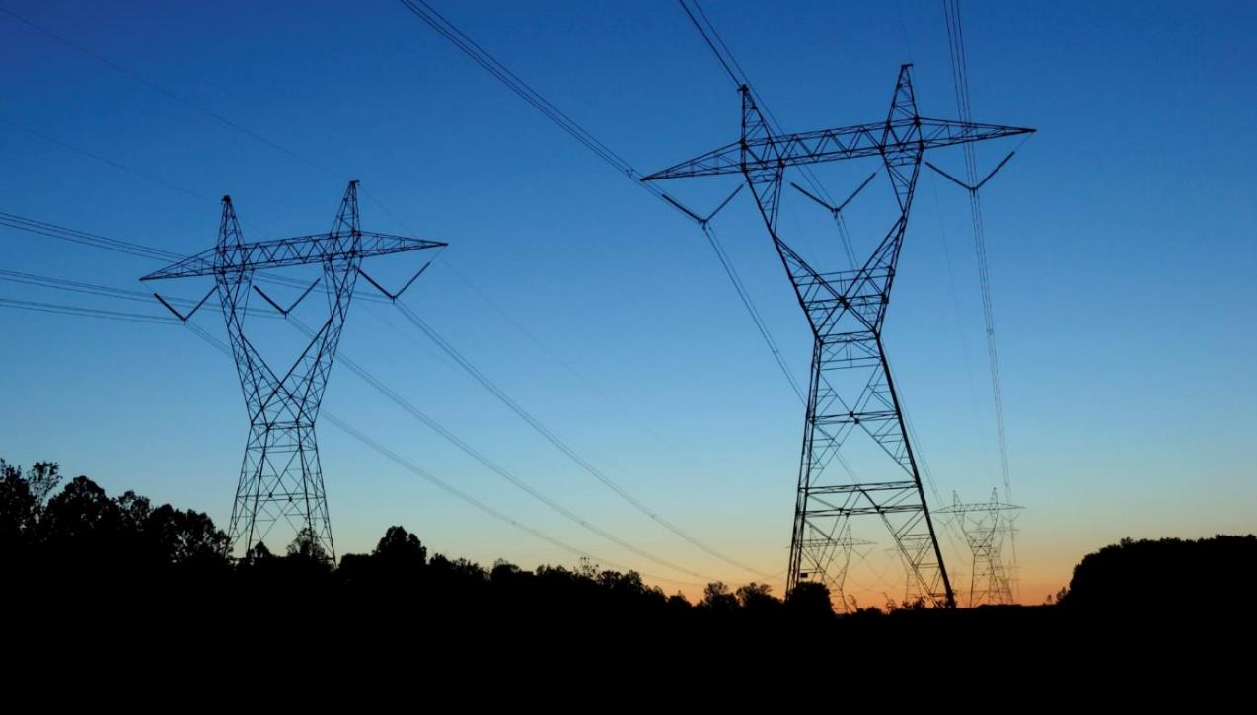
Our Mission:
Helping our members work together to keep the lights on … today and in the future.

Slide 6

Our Major Services
  Facilitation
  Reliability Coordination
  Balancing Authority
  Transmission Service/Tariff Administration
  Market Operation
  Transmission Planning
  Training
OUR APPROACH:
Regional, Independent, Cost-Effective and Focused on Reliability
Notes:
We offer a number of services for our members, including:
Facilitating meetings and decision-making processes
Monitoring the grid to maintain electric reliability
Processing requests for use of the transmission grid under a tariff with consistent rates and terms for all participants
Operating a wholesale energy market
Ensuring that users, owners, and operators of the bulk transmission system are in compliance with federal reliability standards
Creating regional reliability standards
Planning for future transmission needs
With all of our services, we focus on being regional, independent, and cost-effective. Our overarching goal is maintaining electric reliability.

Slide 7

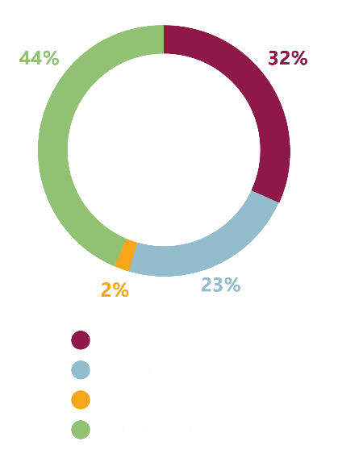
The Value of SPP
Transmission planning, market administration, reliability coordination, and other services provide net benefits to SPP’s members in excess of more than $2.2 billion annually at a benefit-to-cost ratio of 14-to-1.
A typical residential customer using 1,000 kWh saves $7.63/month because of the services SPP provides.

Slide 8
SPP’s 99 Members:
Independence Through Diversity
99 Members
July 12, 2019
Notes:
SPP has one of the most diverse memberships of any Regional Transmission Organization. This diversity helps ensure independence; we carefully balance diverse interests in our decision-making processes.
Investor Owned Utilities: Traditional vertically-integrated utilities
Cooperatives: Rural electric cooperatives
Municipals: Cities
State Agencies: State-created agencies that own/operate facilities
Independent Power Producers/Wholesale Generation: Entities that develop and own generation, but don’t own transmission
Independent Transmission Companies - Entities that develop and own transmission, but don’t own generation
Marketers: Entities that own no facilities or transmission, but buy/sell excess capacity
Federal Agencies
Large Retail Customers

Slide 9
Winds of change

Slide 10

THIS ISN’T OUR PARENTS‘ ELECTRIC GRID
Smart meters
Advanced technologies
Generator retirements
Environmental constraints
Compliance
Cybersecurity
Microgrids
Wind
Energy efficiency
Prosumers
Evolving grid
Electric vehicles
Fuel prices
Battery storage
Solar
Demand response
Consumer demand
Distributed generation
PLANNING FOR AN UNCERTAIN FUTURE

Slide 11
% OF New Electricity Generation in U.S. RTOs
New generation built in each RTO since 2012 including what will be built through 2022
Source: NRDC analysis of S&P Global Market Intelligence data

Slide 12

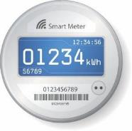
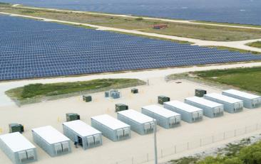
Ensuring reliability for a changing generation mix and new technologies

Slide 13
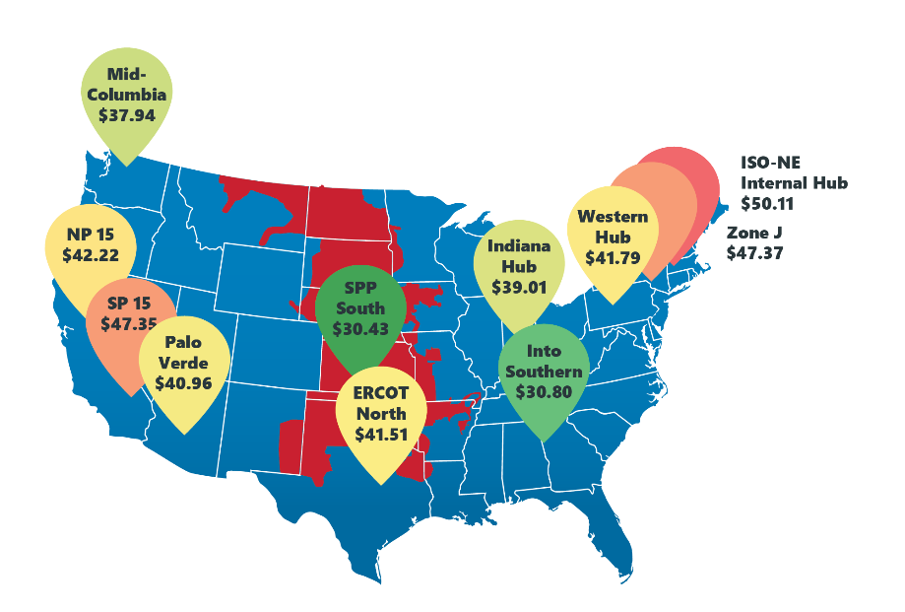
2018 Annual Average Spot Prices
SPP had the lowest average wholesale electricity prices in the nation in 2018.
Source: Federal Energy Regulatory Commission’s 2018 State of the Markets Report (April 18, 2019).
Based on nodal prices from ABB Velocity Suite. ISO hub prices for SNL’s ISO Day-Ahead On Peak Prices data. Mid-Columbia, Palo Verde, and Into Southern prices from SNL’s S&P Global Market Intelligence Day-Ahead – Annual On Peak Prices data.

Slide 14
Why Generation Diversity Matters:
SPP’s record Wind Swing (13.3 GW in 22 hours)
Max @ 21:45 on 3/14: 15,147 MW
Min @ 19:46 on 3/15: 1,843 MW

Slide 15
MIN AND MAX PERCENT OF
GENERATION MIX BY FUEL TYPE
Max
Min
June 2018 – June 2019

Slide 16

Notable Market Initiatives
NDVER to DVER Conversion
~7900 MW of Non-Dispatchable Variable Energy Resources
SPP’s only mechanism to control NDVER output is through out-of-market actions
Conversion results in increased reliability and market efficiencies
FERC Order 841
Incorporates participation model for storage in SPP’s markets
Allows SPP’s market to send dispatch signals to both inject and withdraw energy from the grid
Future enhancements could allow SPP to optimize the state of charge for storage using the participation model
Ramping Capability Product
New market products (Up and Down) that helps ensure SPP has enough rampable capacity to address net load variations
Systematically pre-position resources with ramp capability to manage net load variations and uncertainties while providing transparent price signals to incent resource flexibility
Regulation Up Market for VERS
VERs precluded from participating in ‘Up’ products, except for Energy, because of fuel source uncertainty
Allows for additional competition in the regulation up product
Addresses potential scenarios where grid is primarily renewable
Enhanced VER Data for Forecasting
Individual wind turbine location data
Fast Start Resources
FERC 206 proceeding
Future enhancement could allow commitment of Fast Start Resources in Real-Time Balancing Market
Requires the commitment costs of Fast Start Resources to be included in LMP
Mid-point and corner location data for solar farms
Inverter technology and controls information
Improved forecasting of VERs results in better unit commitment and dispatch, lower production costs, and increased reliability

Slide 17
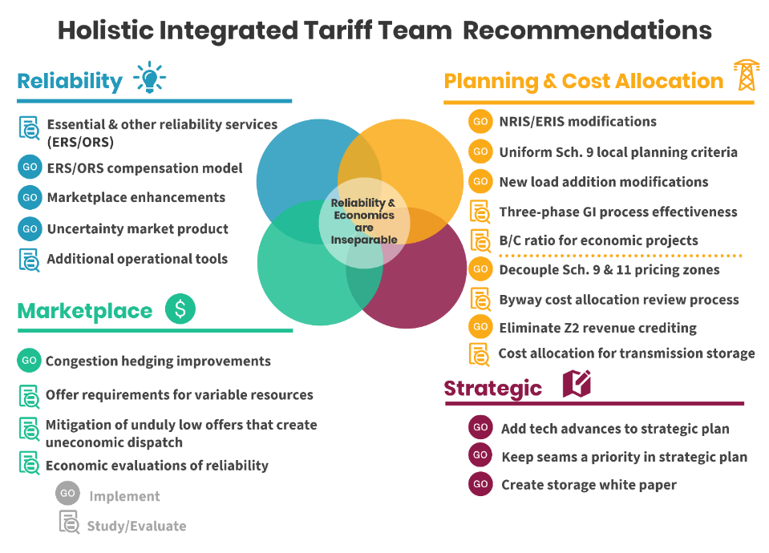

Slide 18
Western Energy Services

Slide 19

Western Energy Services
Western Energy Services is a family of contract-based products offered to new customers in the Western Interconnection
  Unscheduled Flow Mitigation
  Western Reliability Coordination Services
  Western Energy Imbalance Service Market (WEIS)
  Planning coordination (discussing with prospective customers)
RTO membership not required

Slide 20
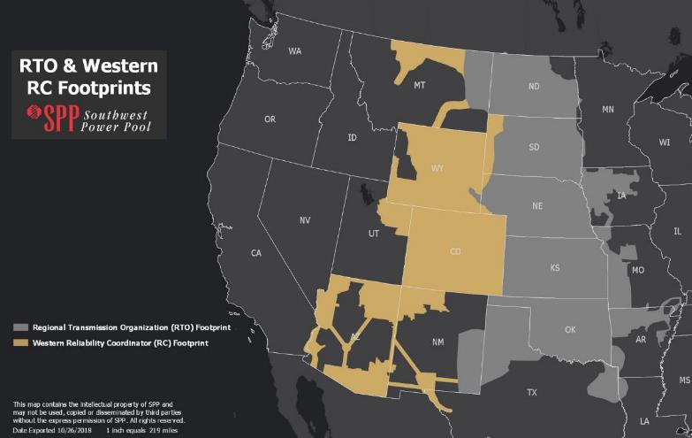
Western Reliability Coordination Services
SPP-provided RC services will go live December 2019
Customers:
Arizona Electric Power Cooperative, Inc.
Black Hills Energy’s three electric utilities: Black Hills Power, Inc., Cheyenne Light, Fuel and Power Company, and Black Hills Colorado Electric, Inc.
City of Farmington, NM
Colorado Springs Utilities
El Paso Electric Company
Intermountain Rural Electric Association
Platte River Power Authority
Public Service Company of Colorado (Xcel Energy)
Tri-State Generation and Transmission Association
Tucson Electric Power
Western Area Power Administration (WAPA) Desert Southwest Region, WAPA Rocky Mountain Region, and WAPA Upper Great Plains – West

Slide 21
WEIS OVERVIEW
Contract-based energy imbalance service market that will:
  Balance generation and load regionally and in real time
  Centrally dispatch energy from participating resources every five minutes
  Respect existing resource-adequacy and transmission service constructs
  Enhance reliability and affordability of electricity delivery
  Provide price transparency of wholesale energy
  Allow parties to trade bilaterally and hedge against transmission congestion
  Take advantage of synergies by leveraging existing SPP systems and processes
Design leverages best practices from SPP’s administration of an EIS market 2007-2014 and foundational constructs already in place in the west

Slide 22
What weis is not…
Consolidated Balancing Authority
Day-Ahead Market
TCRs (Congestion Hedging)
Other Ancillary Services (Remain Responsibility of BA)
Reliability Coordination (Separate RC West Project)
Transmission Planning
Consolidation of Transmission Tariffs

Slide 23


Current WEIS Status
Currently five Market Participants have executed contracts for WEIS Market Services
  Basin Electric
  Tri-State G&T
  WAPA Colorado River Storage Project (CRSP)
  WAPA Rocky Mountain Region (RMR)
  WAPA Upper Great Plains Region (UGP)
Post-launch, SPP will onboard additional market participants according to normal onboarding timelines (approx. every six months)

Slide 24
