Slide 1
Marcus Hawkins Executive Director
TAPS
October 29, 2019

Slide 2
What I plan to talk about
OMS Background
Current areas of state interest
Please interrupt with your questions at any time

Slide 3



Notes:
Congratulations on the milestone
It’s a big deal to have the number of big hits and accomplishments that this organization has
Staying relevant and driving discussion over 30 years is no easy task
OMS recently celebrated our 15 year anniversary
Power of working together
As wholesale markets & technology have evolved, the role of OMS has become increasingly important
Commissions have struggled to replace institutional knowledge
Important to draw upon a broad group of experience
I’d assume TAPS has a similar experience to some extent

Slide 4
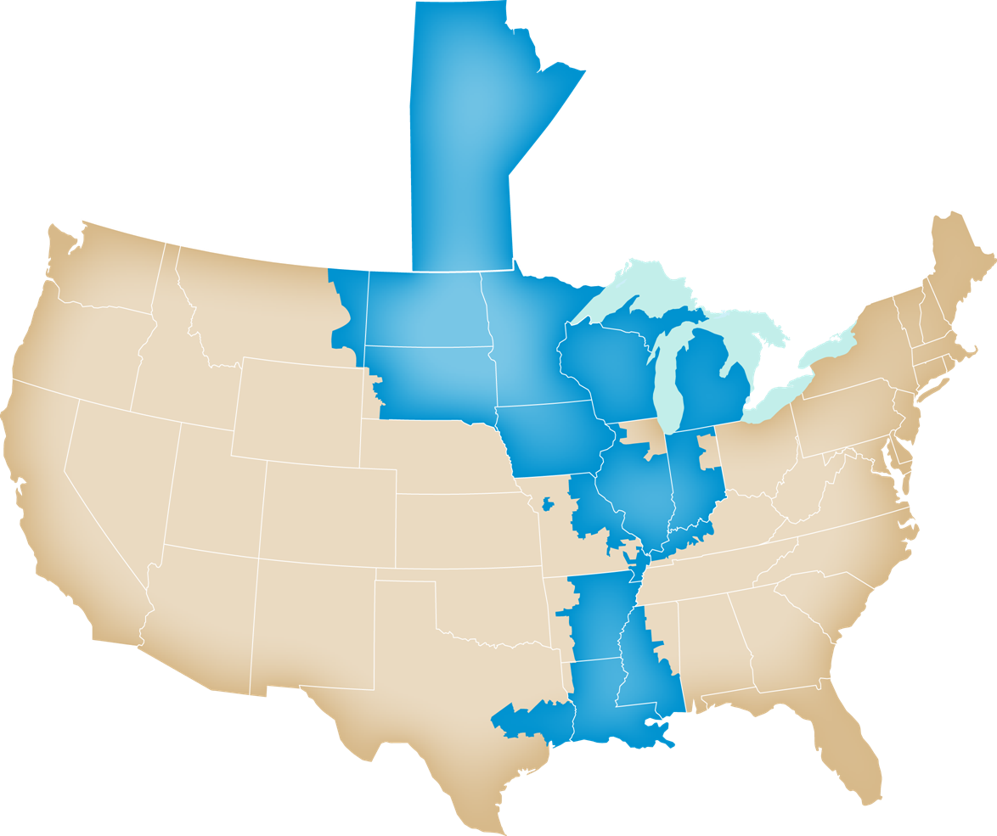
OMS Membership
Arkansas Public Service Commission
Illinois Commerce Commission
Indiana Utility Regulatory Commission
Iowa Utilities Board
Kentucky Public Service Commission
Louisiana Public Service Commission
Manitoba Public Utilities Board
Michigan Public Service Commission
Minnesota Public Utilities Commission
Mississippi Public Service Commission
Missouri Public Service Commission
Montana Public Service Commission
New Orleans City Council
North Dakota Public Service Commission
South Dakota Public Utilities Commission
Public Utility Commission of Texas
Public Service Commission of Wisconsin
Notes:
Also mention associate members
TAPS members located in all MISO states except MS, MT, and Manitoba

Slide 5
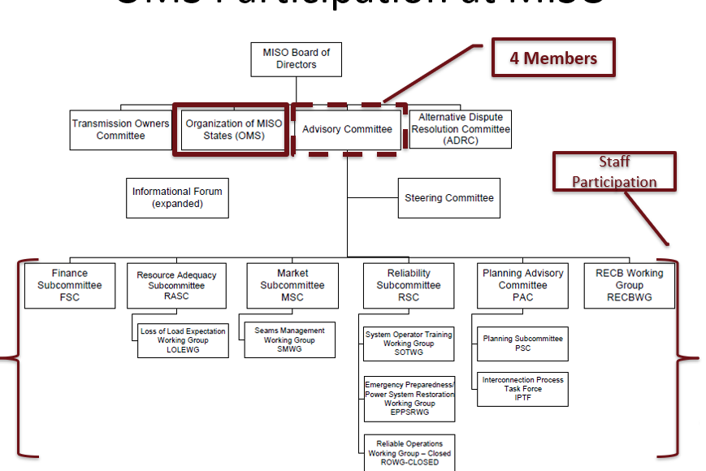
Role of the states at MISO
Advisory in nature
Participate as any other stakeholder would
Unique roles in planning and cost allocation
Notes:
First among equals
Most on AC

Slide 6

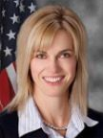




Recent Election of 2020 Officers
OMS Executive Committee
President – Matt Schuerger, MN
Vice-President – Julie Fedorchak, ND
At Large – Sarah Freeman, IN
Secretary – Mike Huebsch, WI
Treasurer – Arthur D’Andrea, TX
Past President – Ted Thomas, AR
Notes:
Out executive committee oversees the day to day operation of the organization.
These members are the most involved in the MISO stakeholder process, at FERC, etc.
President plays a key role in setting priorities

Slide 7

Practical considerations for OMS
Majority of states reside in multiple RTOs
Approval of OMS positions
requires 9 members
monthly board meetings
Members have right to voice their own position within OMS documents
Varied regulatory models
Notes:
Some states are driving the bus
some sit in the back
some are following the bus to school by their own means of transportation.

Slide 8
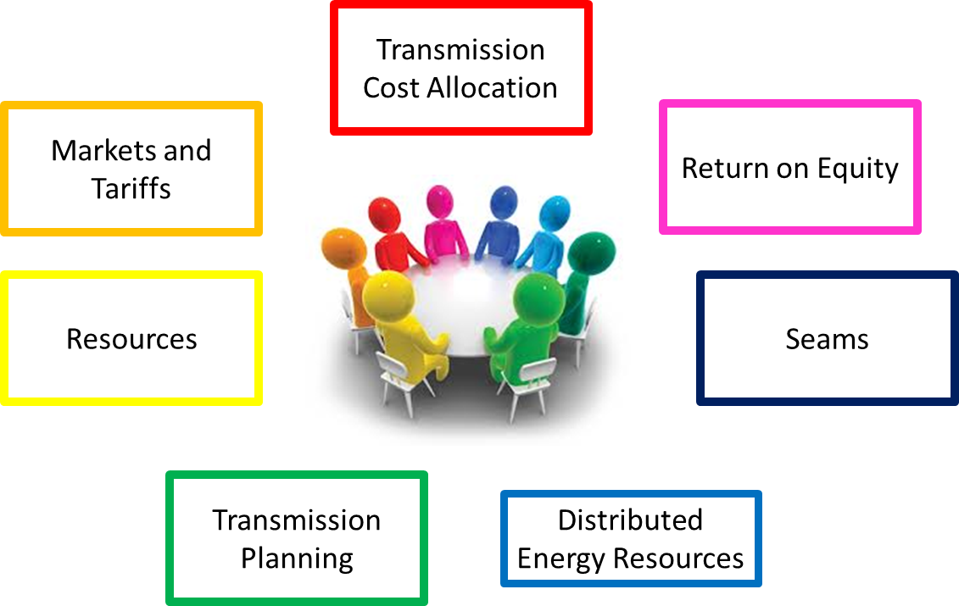
Current OMS Work Groups
Majority of work is developed through staff-led working groups.
Working groups change periodically to align with priorities.
Work groups often provide feedback to MISO.

Slide 9
We have many overlapping interests
TAPS Mission Statement
OMS 2019 Strategic Priorities
TAPS currently engages in legislative debates over proposed changes in rules governing capacity markets, and in transmission planning, siting and cost allocation policies, as well as in proposed changes to regulatory policies governing electric grid security. TAPS retains an interest in legislative policy proposals that impact the jurisdictional boundaries between state and federal regulators over electric energy policy and changes to regional transmission organizations policy.
Long-range transmission planning
DER
Resource Adequacy
Return on Equity
Seams
Notes:
Will talk on a later slide about some expected upcoming work on resource adequacy
OMS/TAPs alignment in NOI on incentives
RTO adder
Keep risk/challenges framework
State vs. federal policy battles that are going on in PJM are happening a little differently w/in MISO
Resource decisions link to DER & transmission planning

Slide 10
Current focus areas

Slide 11
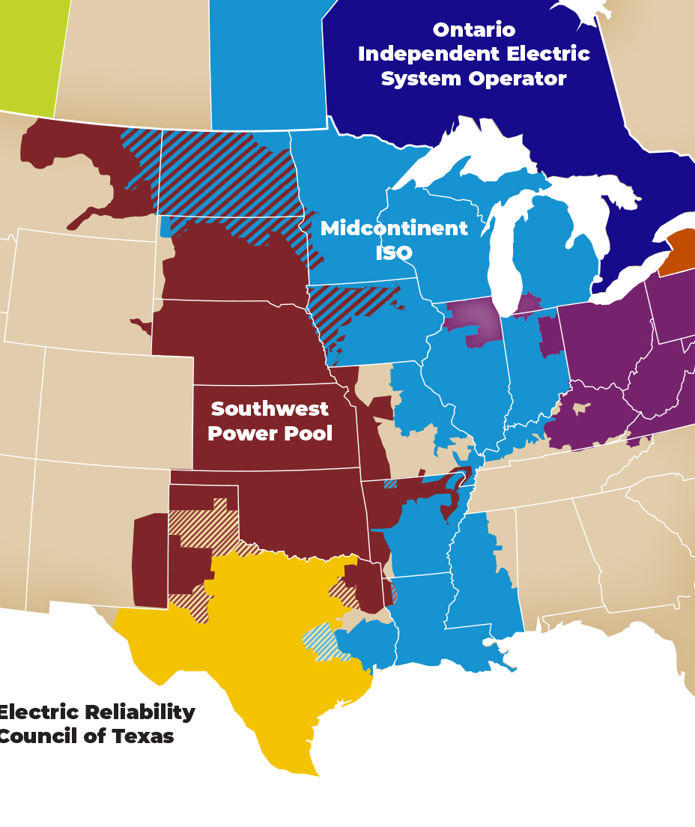
Seams – MISO/SPP Initiative
The OMS has been working with the SPP RSC through the Seams Liaison Committee.
Initial focus on markets and operations
Whitepaper
Stakeholder feedback
Expecting initial results from Market Monitor Analysis very soon
Joint dispatch
Rate pancaking
Market-to-Market
Notes:
Long, complex seam
Some issues are big for single entities, but not from an overall market perspective
different issues in different areas

Slide 12
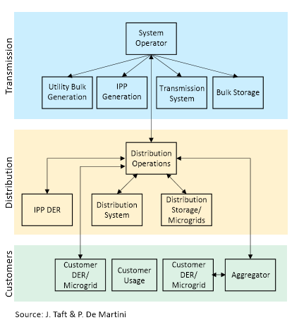
Distributed Energy Resources (DERs)
Focus areas:
Jurisdictional overlap
T-D Interface
Joint priorities with MISO
Working to ensure work going on at state-level is understood by MISO, including improvements being made to interconnection, visibility, and structure of retail programs.
Monitoring MISO’s Market System Enhancement to understand future functionality.
Notes:
Difficulty getting right people in the discussions
Attempting to understand state-led grid-mod efforts, and rate design, impact on wholesale markets

Slide 13
Cost Causation & Beneficiary Assessment
Federal & International Examples
Current RTO examples
Views from experts
Stakeholder perspectives
Event with the Midwest Governor’s Association on Nov 5-6 in St. Louis
Educating membership on state of the art for benefit assessment methods
Frank discussions on why this topic is so difficult
Part of our long-range transmission planning efforts
Recently approved set of principles
Notes:
LRTPP
Value in moving ahead with analysis now, given timeline
Intended to start a conversation
Importance of state input in future resource outlook
Look at changing needs of Tx system
Beneficiary pays

Slide 14
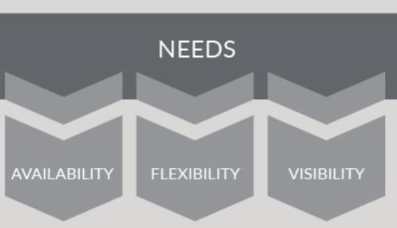
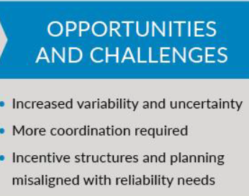
Resource Availability and Need
OMS is actively engaged in these discussions, focused on:
Potential impacts to accreditation
New “attributes” and how they are acquired, including the role of market signals
OMS was supportive of early efforts
Demand response
Outage coordination

Slide 15

Anything else?
Marcus Hawkins
Executive Director
marcus@misostates.org
Ben Sloan
Director of Regulatory Affairs
ben@misostates.org
Colleen Dougherty
Office Manager
colleen@misostates.org

